Slide 1
DataSpark - Illuminating Insights for Global Electronics
REPORT
By:
MUGESH SURYA PRADEEP

Slide 2
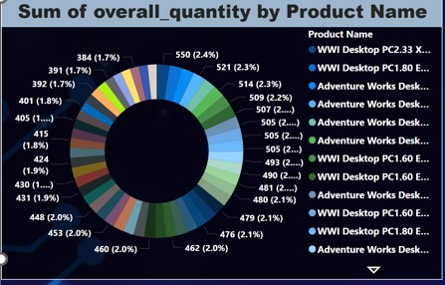
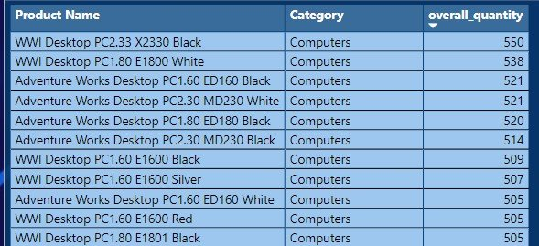
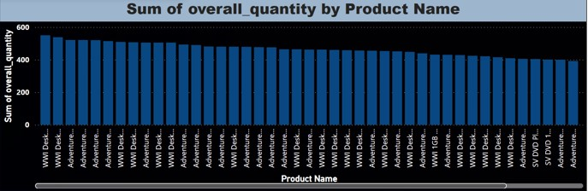
Product Analysis
Product analytics data is used to determine what kind of user experience of our product or service offers, using real customer feedback and behavioral data to inform future product updates or improvements.
1. Product Analysis Based on the Quantity :By visualizing the product data, I conclude that the WWI Desktop PC2.33 X2330 Black is the best-selling product with an overall quantity sold of 550 units. Here we can clearly see the Bar-graph , Pie-chart and table of top 10 product sold.

Slide 3
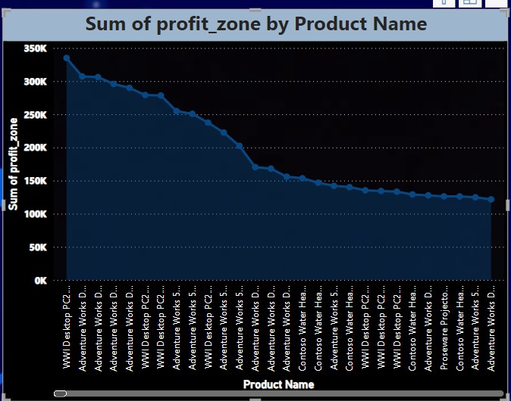
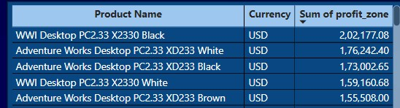
Product Analysis
2.Product Analysis Based on the Profit: By analyzing the product profit, I conclude that the highest profit product is the WWI Desktop PC2.33 X2330 Black, with a profit of $202,177.08. Below, I show the prices of the top 5 products

Slide 4
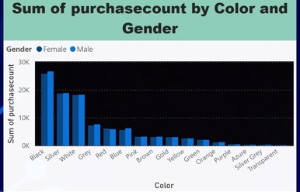
Customer Analysis
Gender Analysis:
Gender Analysis is the process of understanding the people`s interest with respect to gender.
1. Gender Analysis Based on the color: The outlook and color of the product are the most important factors for customers when selecting a product. Here, I am analyzing the color preferences of products with respect to gender. I conclude that black is the most preferred color, irrespective of gender.

Slide 5
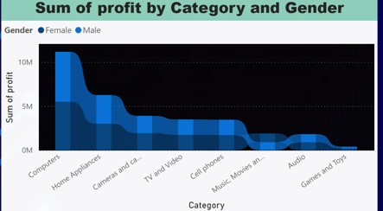
Customer Analysis
2.Gender Analysis Based on the Category of Purchase:
The interest in purchasing products varies by gender. Males tend to focus more on tech products, while women are more interested in music, movies, audiobooks, cameras, and camcorders

Slide 6
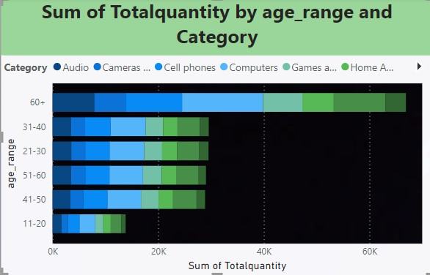
Customer Analysis
Age Analysis:
Age analysis is the process of understanding people's interests with respect to different age categories by using real-time data.
1. Category of product purchases based on age: The products purchased by people based on age categories clearly show that the highest purchases are from those aged 60 and over .From the graph, we analyze that computers are the highest purchased category. Surprisingly, older adults also purchase gaming products.

Slide 7
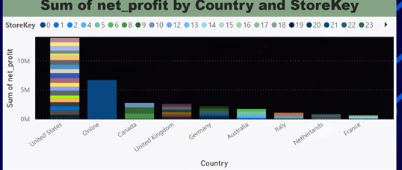
Store Analysis
Store analysis is the process of understanding the market by examining the revenue of various stores.
Store Analysis based on the stores: Analyze the store collection based on the profit generated. Clearly, online sales generate higher revenue than physical stores, but overall sales in physical stores in the United States exceed those from online stores.

Slide 8
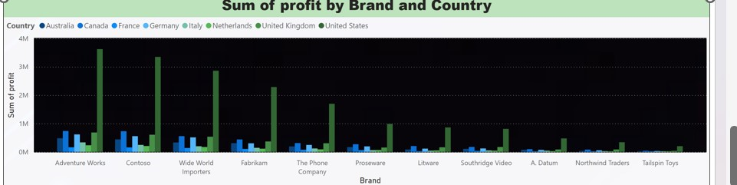
Sales Analysis
Brand analysis is the process of understanding the market by examining the profit of the brand with respect to different countries. Based on the analysis, all the companies hold a strong market presence in the United States. Adventure Works has a strong hold in all countries.

Slide 9
Thank You

